Slide 1
Coursera capstone
Opening a Gym a Chicago
Sahil Desai

Slide 2
Business Problem
Location of the gym will be one of the deciding factors in determining opening success
Objective: To analyze and select the best suburbs or neighborhoods in Chicago
Find an area where gyms are not available, and avoid areas that have too many gyms
Business Question
Where would be the best area to build a new gym in Chicago as an aspiring gym owner?

Slide 3
Data requirements
Neighborhoods/Suburbs in Chicago
Latitude and Longitude coordinates of each neighborhood that is webscraped
Venue data with emphasis on gyms
Data Source
Wikipedia page https://simple.wikipedia.org/wiki/Category:Suburbs_of_Chicago,_Illinois
Foursquare to make API calls and retrieve needed venue data
Geocoder package to get coordinates

Slide 4
Methodology
Webscrape off Wikipedia page to get list of neighborhoods
Get the latitude and longitude coordinates for each neighborhood using Geocoder
Use Foursquare to make API calls for venue data
Grouping data by neighborhood and taking average frequency of each venue occurrence in neighborhoods
Filter venue category for gyms
Perform unsupervised learning algorithm k-means-clustering for analysis
Visualize clusters using Folium

Slide 5

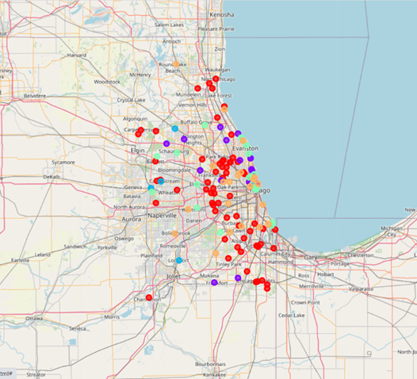
Results
Categorized neighborhoods into 5 clusters
Cluster 0: Neighborhood with no number of shopping malls (red)
Cluster 1: Neighborhood with moderate concentration of shopping malls (blue)
Cluster 2: Neighborhood with high concentration of shopping malls (light blue)
Cluster 3 Neighborhood with moderate concentration of shopping malls (light green)
Cluster 4 Neighborhood with low concentration of shopping malls (green)

Slide 6
Discussion
Cluster 0 takes a heavy portion of the neighborhoods and is widely scattered across near inner city and outer suburbs. However, I interpreted this to be inaccurate as many of these areas are close to other clusters. Foursquare didn’t have any gym data over locations in this cluster unfortunately.
Clusters 1 and 3 which have moderate amount of gyms and would remotely difficult to open a gym there
. Cluster 2 is the smallest and has most gyms out of any cluster
. Cluster 4 has low amount of gyms

Slide 7
Conclusion
In this project, we have gone through the process of identifying the business problem, specifying the data required, extracting and preparing the data, performing unsupervised machine learning by clustering the data into 5 clusters based on their similarities, and lastly providing recommendations to the relevant stakeholders (gym contractors, gym owners, property developers etc.) regarding the best locations to open a new gym. I would have liked my API call to capture more information about Chicago venues that were categorized as gyms, because I had a large cluster unrealistically portray a big part of the city not having gyms. But based off my findings, we still found clusters that had high and low competition. As to answer the business question that was raised in the introduction section, the answer proposed by this project is: The neighborhoods in cluster 4 are the most preferred locations to open a new gym. The findings of this project will help those to make an informed decision on choosing high potential locations while avoiding over competitive areas in opening a new gym.

Slide 8
THE END

